Slide 1
Unit 2
Richard Palmer

Slide 2
## ## Attaching package: 'dplyr'
## The following objects are masked from 'package:stats': ## ## filter, lag
## The following objects are masked from 'package:base': ## ## intersect, setdiff, setequal, union
## ## Attaching package: 'plotly'
## The following object is masked from 'package:ggplot2': ## ## last_plot
## The following object is masked from 'package:stats': ## ## filter
## The following object is masked from 'package:graphics': ## ## layout
## Registered S3 methods overwritten by 'ggalt': ## method from ## grid.draw.absoluteGrob ggplot2 ## grobHeight.absoluteGrob ggplot2 ## grobWidth.absoluteGrob ggplot2 ## grobX.absoluteGrob ggplot2 ## grobY.absoluteGrob ggplot2

Slide 3
Question 1
Show the number of players per position

Slide 4
Question 2
Compare the distribution of weight of centers with that of the weight of forwards
## Warning: Removed 3 rows containing non-finite values (stat_bin).

Slide 5
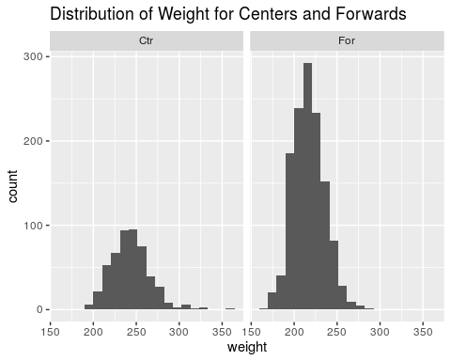

Slide 6
Question 3
Compare the distribution of the height of centers with that of the height of forwards

Slide 7
Question 4
Investigate distribution of height across all positions

Slide 8
Question 5
Investigate how a players height is related to his weight
## Warning: Removed 6 rows containing missing values (geom_point).

Slide 9
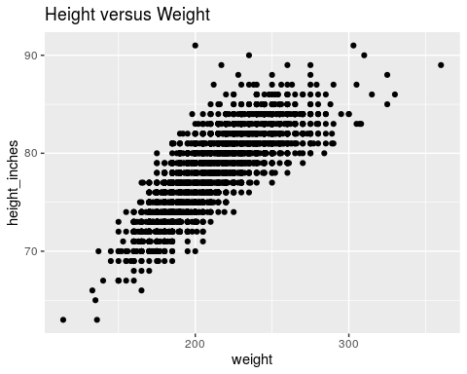

Slide 10
Question 6
Is there any difference in height/weight relationship among positions?
## Warning: Removed 6 rows containing missing values (geom_point).

Slide 11
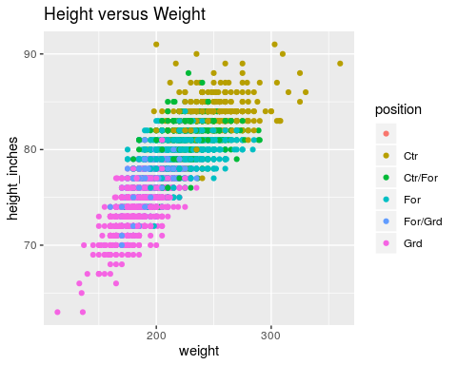

Slide 12
Question 7
Is there any evidence that height has changed over the years?
## Warning: Removed 1 rows containing missing values (geom_point).

Slide 13
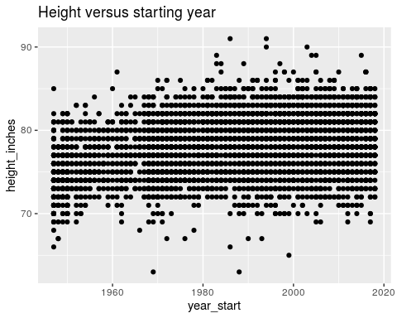

Slide 14
## Question 8 3D plot of height versus weight versus year, colored by position

Slide 15
Question 9
Visualize some new aspect of the data

Slide 16
Question 10
Test the claim that the distribution of income increases as the education level rises.

